Slide 1

1. Sample
2. Record
3. Replace

Slide 2

1. Sample
2. Record
3. Replace

Slide 3

1. Sample
2. Record
3. Replace

Slide 4



1. Sample
2. Record

Slide 5

1. Sample
2. Record

Slide 7
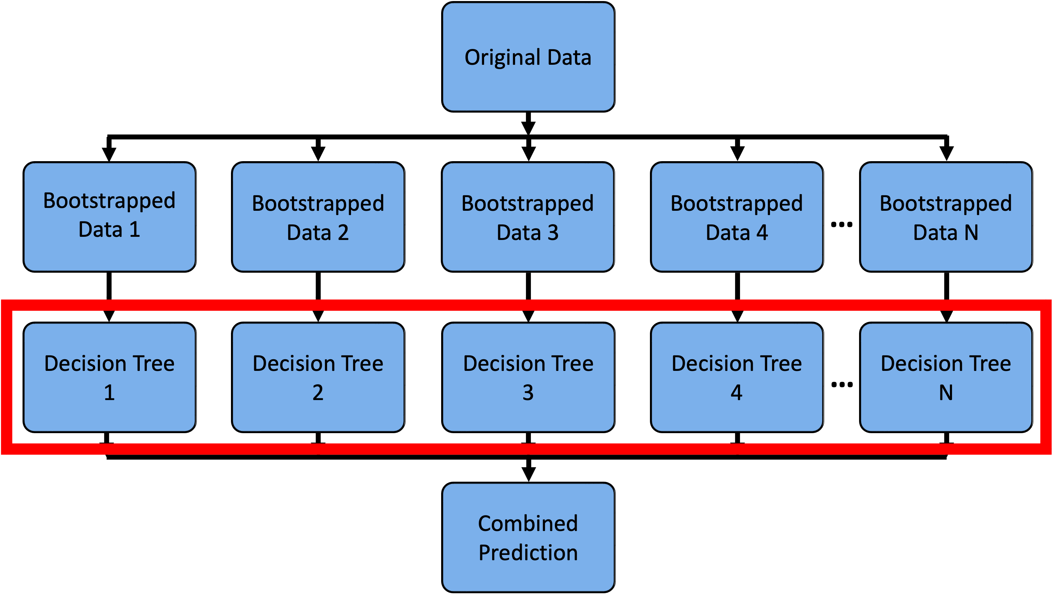
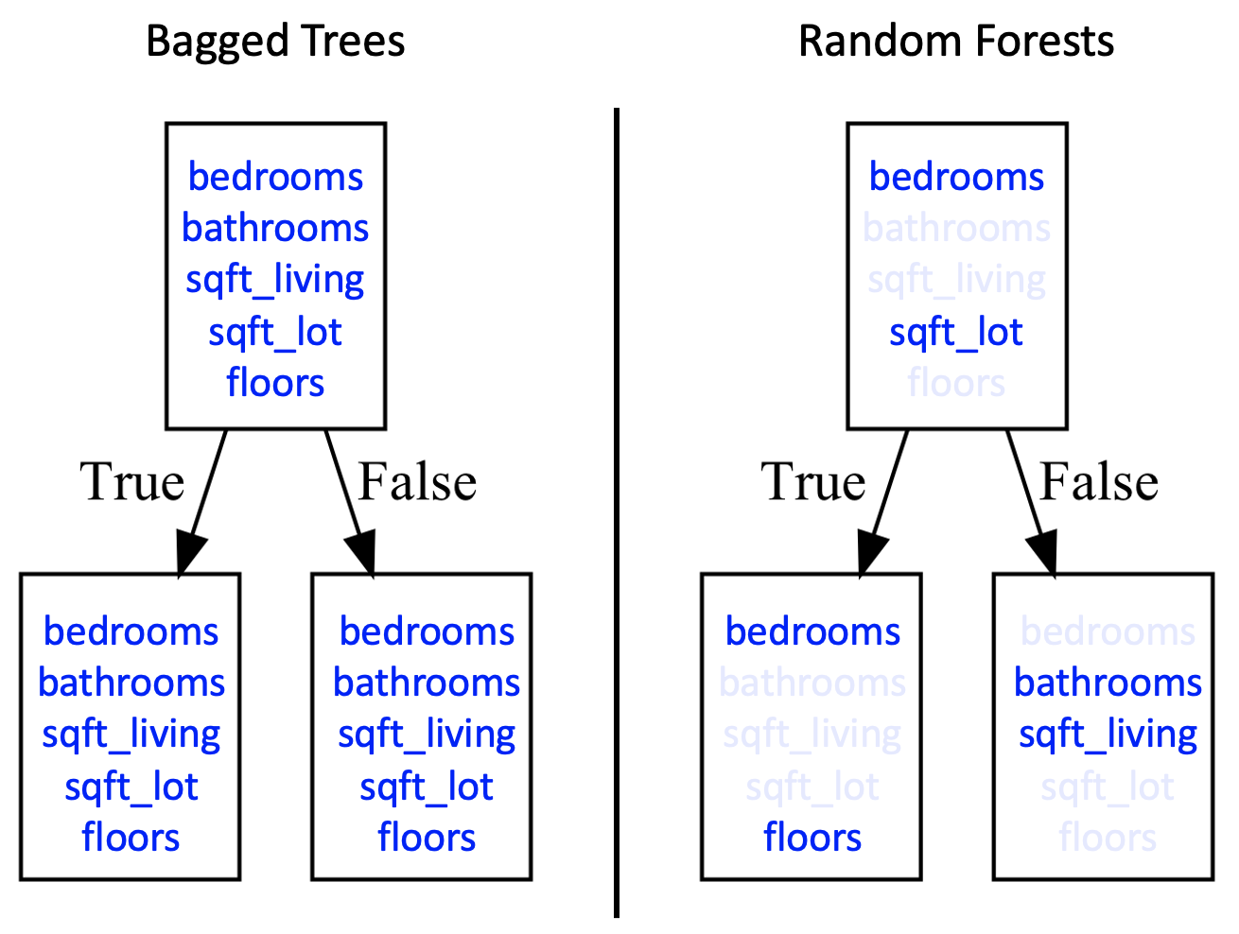
How Splits are Selected
Bagged Trees: At each split, all features (p) are considered as candidates.
Random Forests: At each split, only a random subset (m features) is selected as candidates from all features (p).
Notes:
Classification trees are essentially a series of questions designed to assign a classification

Slide 8
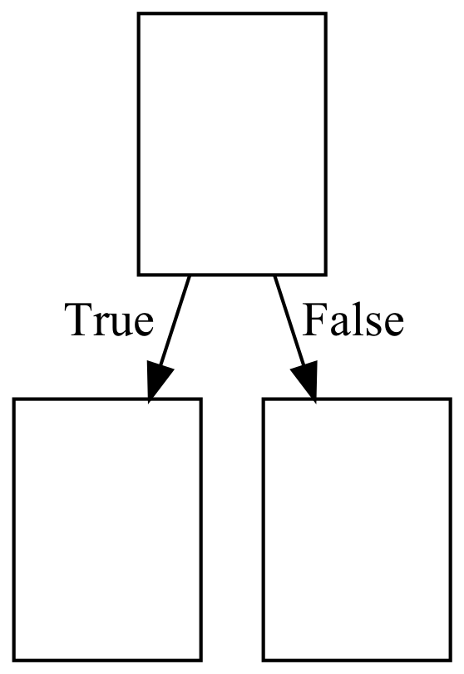
Bagged Trees
Random Forests
bedrooms
bathrooms
sqft_living
sqft_lot
floors
bedrooms
bathrooms
sqft_living
sqft_lot
floors
bedrooms
bathrooms
sqft_living
sqft_lot
floors
bedrooms
bathrooms
sqft_living
sqft_lot
floors
bedrooms
bathrooms
sqft_living
sqft_lot
floors
bedrooms
bathrooms
sqft_living
sqft_lot
floors
In contrast to Bagged Trees, for each decision tree in Random Forests, only a subset of features are randomly selected at each decision node and the best split feature from the subset is used.

Slide 9
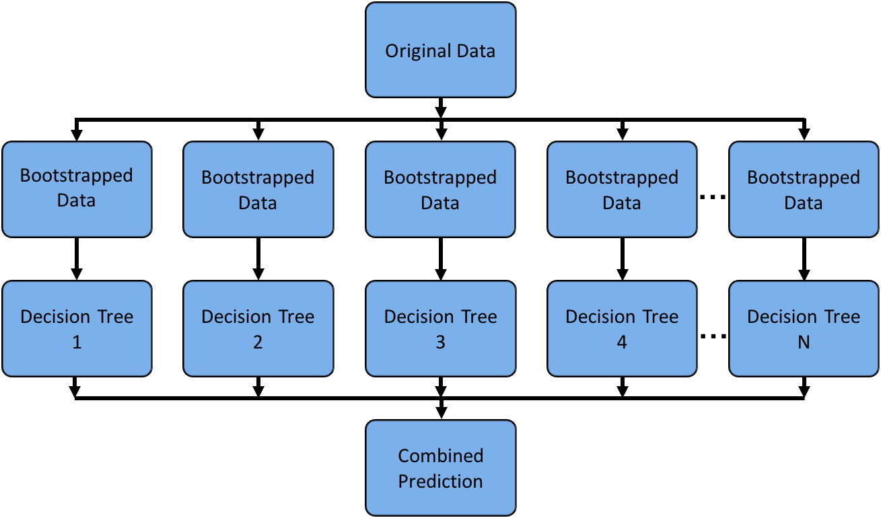
Random Forests
Random Forests offer a slight variation on bagged trees.
The difference is that when building each tree, each time a split is considered, a random sample of m features is chosen as split candidates from the full set of p features. The split is only allowed to use one of those m features.
A new random sample of features is chosen for every single tree at every single split.
For classification, m is typically chosen to be the square root of p
For regression, m is typically chosen to be somewhere between p/3 and p.
The area enclosed in the red rectangle is a place where the random forest algorithm differs from the bagged tree algorithm.
Notes:
Classification trees are essentially a series of questions designed to assign a classification

Slide 10
Original Data
Bootstrapped
Data 1
Bootstrapped Data 2
Bootstrapped Data 3
Bootstrapped Data 4
Bootstrapped Data N
…
Bootstrap
Decision Tree 1
Decision Tree 2
Decision Tree 3
Decision Tree 4
Decision Tree N
…
aggregating
Combined Prediction
Bagging
Notes:
Classification trees are essentially a series of questions designed to assign a classification

Slide 11
Original Data
Bootstrapped
Data 1
Bootstrapped Data 2
Bootstrapped Data 3
Bootstrapped Data 4
Bootstrapped Data N
…
Decision Tree 1
Decision Tree 2
Decision Tree 3
Decision Tree 4
Decision Tree N
…
Combined Prediction
Notes:
Classification trees are essentially a series of questions designed to assign a classification

Slide 12
Original Data
Data
Data
Data
Data
Data
…
Decision Tree 1
Decision Tree 2
Decision Tree 3
Decision Tree 4
Decision Tree N
…
Combined Prediction
Notes:
Classification trees are essentially a series of questions designed to assign a classification

Slide 13
Original Data
Bootstrapped
Data 1
Bootstrapped Data 2
Bootstrapped Data 3
Bootstrapped Data 4
Bootstrapped Data N
…
Decision Tree 1
Decision Tree 2
Decision Tree 3
Decision Tree 4
Decision Tree N
Random forests train their decision trees differently than bagged trees.
…
Combined Prediction
In random forests, when building each tree, each time a split is considered, a random sample of m features is chosen as split candidates from the full set of p features. The split is only allowed to use one of those m features.
Notes:
Classification trees are essentially a series of questions designed to assign a classification

